Slide 1
Ethics & Biases of Big Data-Decision Making: Predictive Policing
Camille Fougere
Advisor: Ellie Pavlick
Notes:
Hi everyone! Today I’ll be discussing my research across this past semester investigating ethics and biases as related to basing decision-making on big data. I will be analyzing the case study of Predictive Policing to illustrate these two topics

Slide 2
What is Big Data Decision-Making?
Examples:
Using a FitBit
Deciding whom to date
Deciding what colleges are worth attending*
Deciding whether a convicted criminal is likely to re-offend*
* Weapons of Math Destruction: How Big Data Increases Inequality and Threatens Democracy, Cathy O’Neil
Notes:
Big Data decision-making refers to relying on insights from big data or suggestions from big data to make decisions. Current applications of big data decision making in our society range from decisions like deciding when to sleep or how long to work out for based off of a Fitbit to deciding whether a convicted criminal is likely to re-offend

Slide 3
Ethics for Big Data Decision-Making:
When is it “ethical” to use big data to inform decision making?*
Is the model interpretable and transparent to those involved and affected?
Can the model be scaled outside of its intended application?
Does this model have the potential of creating damage?
* Weapons of Math Destruction: How Big Data Increases Inequality and Threatens Democracy, Cathy O’Neil
Notes:
Ethics for Big Data Decision-Making answer the question: how does this technology relate to concepts of “good” and “bad” and “right” and “wrong”? Author Cathy O’Neil provides a great framework for understanding if an application of big data to decision-making is an unethical one, what she calls a “Weapon of Math Destruction” or a WMD. The three questions are “is the model interpretable and transparent to those involved and affected”, “Can the model be scaled outside of its intended application”, and “does this model have the potential of creating damage?”

Slide 4
Biases of Big Data Decision-Making
What are potential fallibilities of using a machine learning model to inform decisions?
Flaws in the data
Flaws in the algorithm
Flaws in interpretation
Notes:
Potential sources of bias in big data decision making can have major ramifications, especially if the model directly affects the well-being of its audience or can be considered a WMD. Sources of bias can be related to the context of the problem, the decision-making processes involved, or the algorithm itself. We can conceptualize where bias can sneak in as three main locations: flaws in the data, flaws in the algorithm, or flaws in the interpretation of the ouptut.

Slide 5
Predictive Policing Case Study
Based on the PredPol software company and existing research in the field
Notes:
I will now delve into the topic of Predictive Policing, a particularly controversial application of big data decision making. I will first analyze predictive policing under our ethical framework to understand how it relates to issues of transparency, scalability, and damage-creation, and to illustrate the particular potential sources of bias, I have created a very simple predictive policing algorithm myself.

Slide 6
Predictive Policing
Using police record data to understand crime patterns
PredPol, LASER, Azavea, KeyStats
L.A., N.Y.C., Chicago, + more
*Predictive Policing Explained, Tim Lau (Brennan Center for Justice)
Notes:
Predictive policing refers to the practice of using police record data to understand crime patterns in the hopes of allocating resources more efficiently to prevent crime and decrease crime rates. There are many lucrative that sell predictive policing software, such as PredPol, LASER, Azavea, and Key Stats. Predictive policing software has been utilized in cities such as LA, NYC, and Chicago.

Slide 7
Ethics of Predictive Policing
Transparency?
Scalability?
Damage?
*Predictive Policing Explained, Tim Lau (Brennan Center for Justice
Notes:
First, let’s apply O’Neils definition of ethical considerations to predictive policing. Firstly, are predictive policing companies and the cities that use them clearly sharing with their surrounding communities how the technology works and how they base decisions on it? Historically, no, many companies including the most popular, PredPol, refuse to release the entirety of the code they use and the data they use and creates a lack of transparency between the companies and the city, and the surrounding community. Secondly, can predictive policing tech be scaled outside of its intended use? This is actually a topic we will continue to expand on, but in some cases, no. Predictive policing software was originally designed to help police track and prevent serious, violent crime. This includes crimes like robbery, assault, and homicide. However, violent crime can be difficult to predict. Unfortunately, non-violent or nuisance crime is a lot easier to predict (and I will explain the importance of this later). So many companies/cities use both violent and nonviolent crime data in their predictions, are more easily able to make arrests for nonviolent crimes, but their number of arrests goes up so the model appears successful. In terms of creating damage, any software that decides where to send police has a direct effect on where people are more likely to be caught for crime, inherently creating a divide between people that may be likely to be arrested and enter the prison system and people who may be less likely.

Slide 8
Biases of Predictive Policing
Does predictive policing software avoid problematic biases?
Training Data bias
Algorithmic Focus bias
Interpretation bias
Feedback loop bias
How can we conceptualize how these biases could play a role?
Notes:
There are several potential sources of bias in implementing predictive policing that I will introduce, including training data (and reporting) bias, algorithmic focus bias, interpretation bias, and bias from feedback loops. In order to conceptualize how these biases could play a role in a predictive policing model, I created my own (very simple) one to show each of these four biases.

Slide 9
Creating a Predictive Policing Algorithm
Based on To Predict and Serve? and Randomized Controlled Field Tests of Predictive Policing

Slide 10
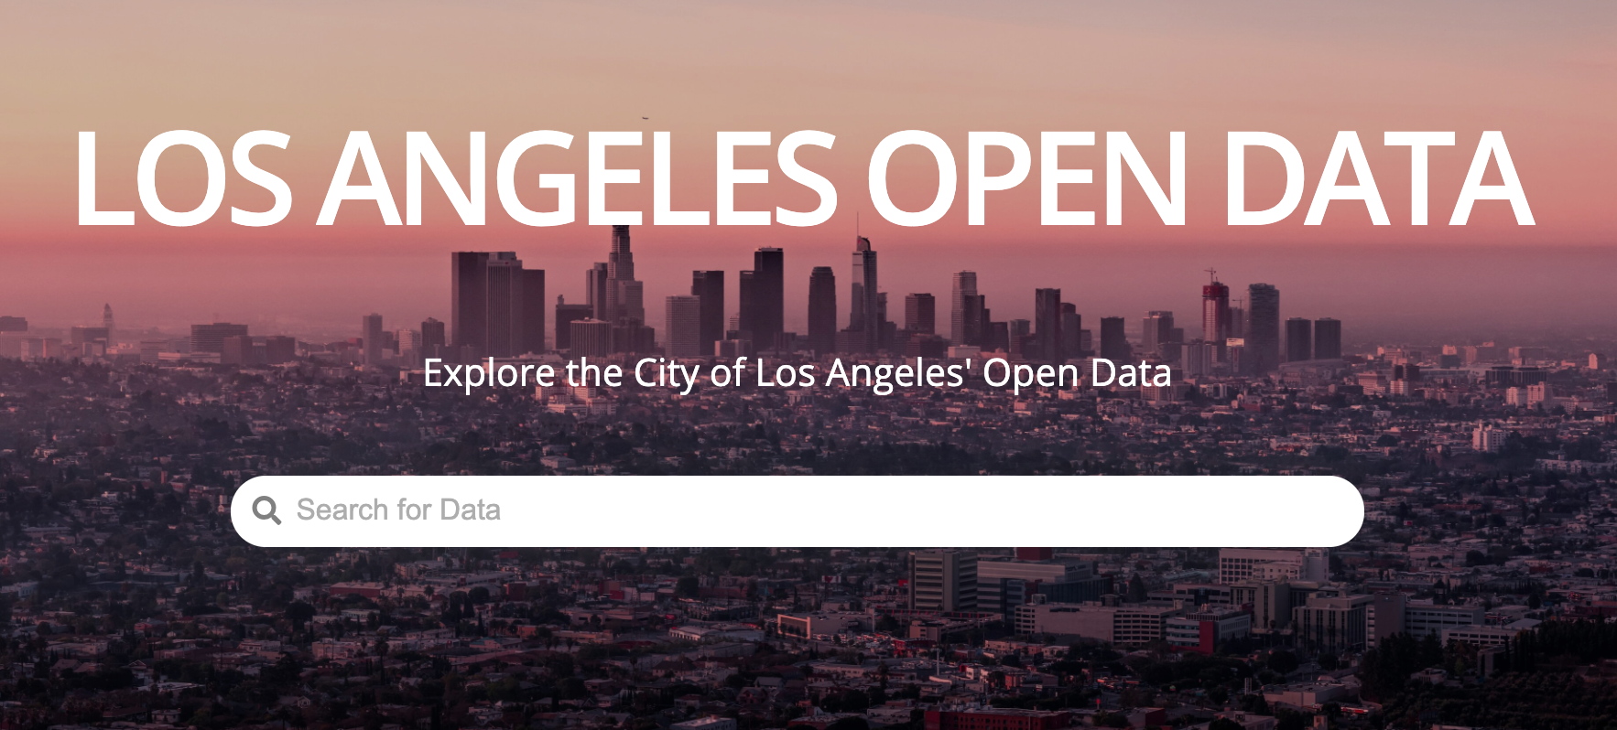
Data
L.A. crime data for January, 2012 (from police reports)
From L.A.’s Open Data initiative*
Excludes crimes not tagged with locations
*https://data.lacity.org/
Notes:
Because PredPol, the most popular predictive policing software, came from and was utilized early on in L.A., I took Los Angeles crime data from a couple years after it was implemented, in 2012. I had to scale down my dataset to just January due to size constraints, but developed a model that will predict day by day estimations of how much crime will occur in each zip code of L.A. across January 2012. The model will only take in data surrounding the time, location, and type of crime (as do many predictive policing algorithms in hopes of avoiding person-based biases), so I needed to exclude crimes that were not tagged with locations.

Slide 11
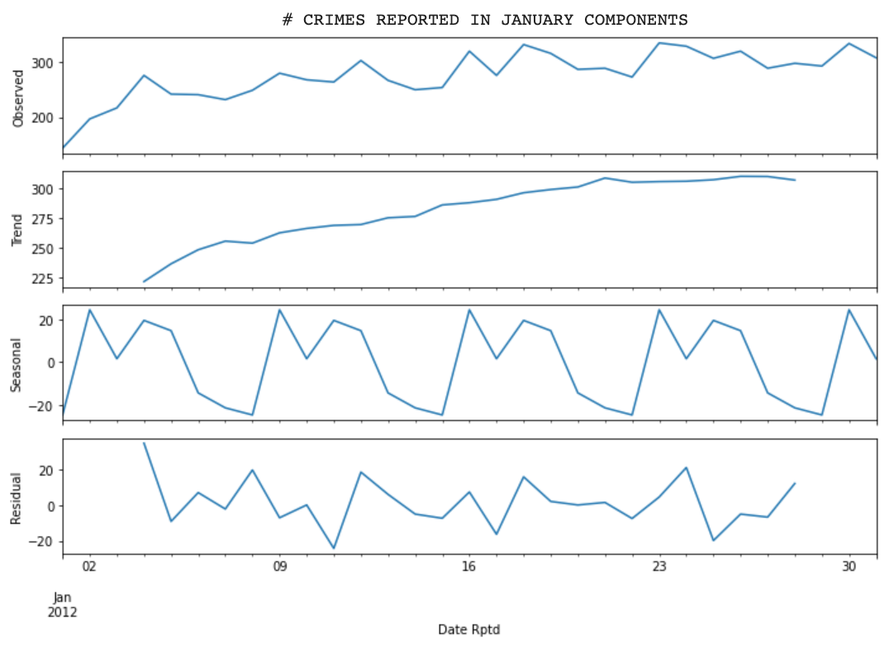
Predictive Model
Holt-Winters exponential smoothing model
Positive trend
Seasonal component (week)
Weighs recent data more
Applied on a rolling basis
Notes:
I investigated the trend how many crimes were reported each day across January and decided the best type of model to use would be a Holt-Winters exponential smoothing model. This takes into account trend in data and seasonal components as well as weighs recent data more than older data. For each day in January, I took all previous data for each zip code and made a prediction about how much crime would occur the next day in each zip code.

Slide 12
Training Data/Reporting Bias
Is police reporting data representative?
Rates of report vary across demographics¹
Trust in police correlated with likelihood of report¹
Example:
Center for Public Integrity identified major discrepancy between # of sexual assaults reported by universities across U.S. and # of sexual assaults reflected by victim-support groups/resources on campus²
1 Predictive Policing: Bias in, Bias Out, Kristian Lum
2 The Mismeasure of Crime, Clayton Mosher, Terance Miethe, and Timothy Hart
Notes:
Now that I’ve introduced the dataset and type of model, I’ll introduce the first relevant bias that could impact our model. Training data bias refers to scenarios in which the dataset is not representative of what the “ground truth” is. In this case, the data is police report data, illustrating where crimes were reported or police discovered crime. However, the ground truth that needs to be represented is about the actual crimes themselves, not just the ones that get caught. As such police reporting data is susceptible to training data bias. Another bias that ties directly in here is reporting bias, which argues that different types of people are more likely to report crime, with those who trust police more likely to report to them, and therefore the police report data may be inconsistent across demographics as well.

Slide 13
Interpretation Bias
What is a predictive policing model predicting?
Training data for model is police reports
Model is predicting where crime is likely to be reported
Model’s output interpreted as where crime is likely to occur
Notes:
Another relevant bias that ties into the previous two is interpretation bias, which refers to scenarios in which the output of a model is interpeted as something that it is not. In this case, a model trained on police report data will learn how to predict where crimes will be reported. However, in many cases, predictive policing algorithms are conceptualized as predicting where crimes will occur.

Slide 14
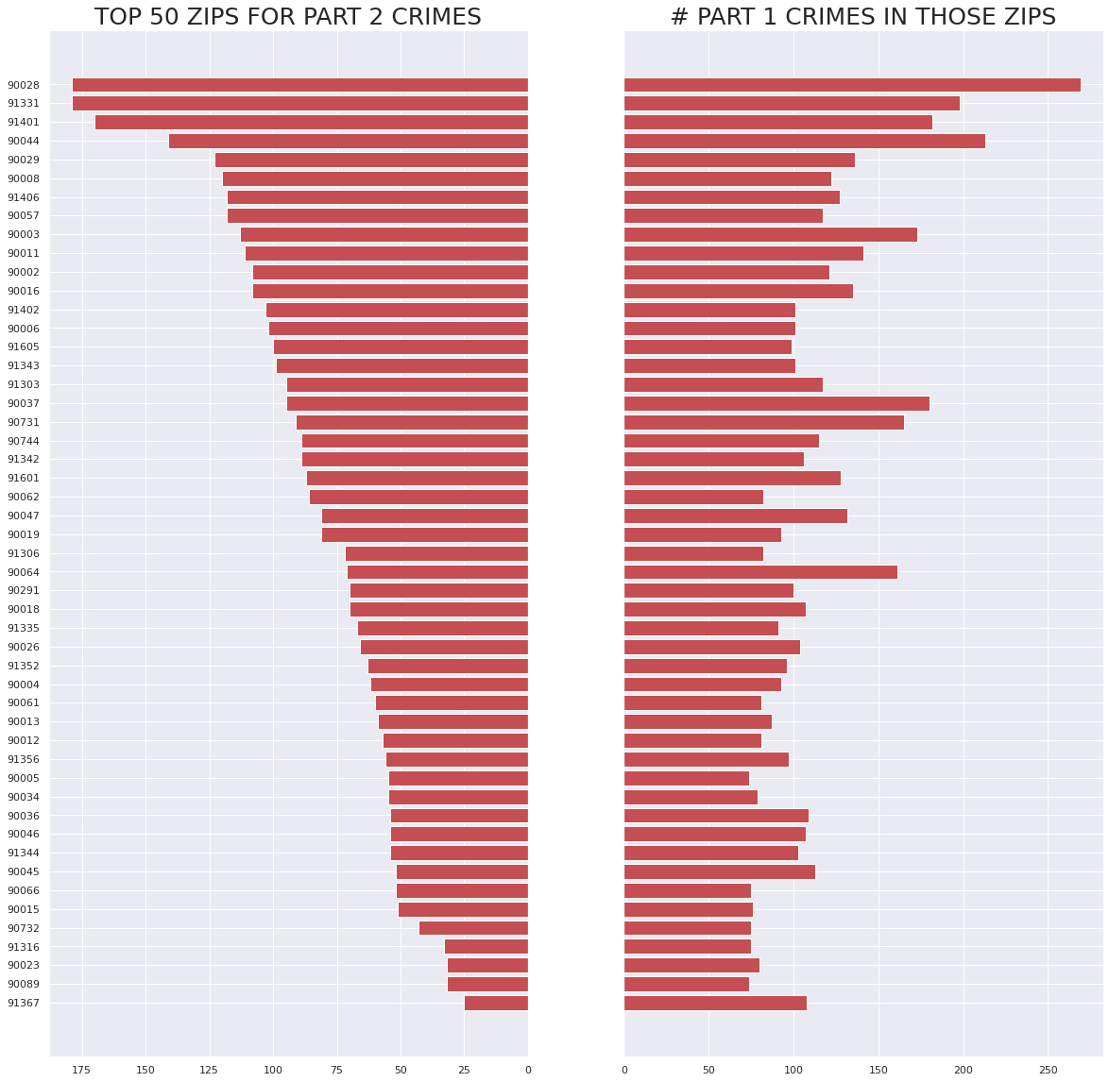
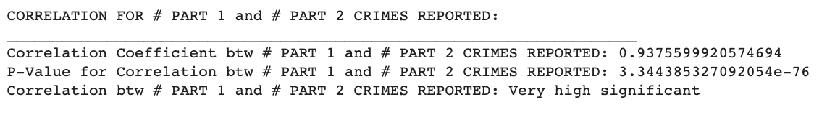
Algorithmic Focus Bias
What crimes does predictive policing aim to “catch”?
Part 1 vs. Part 2 crimes highly correlated, but Part 2 crimes often endemic to low-income neighborhoods*
Part 2 crimes easier to predict*
* Weapons of Math Destruction: How Big Data Increases Inequality and Threatens Democracy, Cathy O’Neil

Slide 15
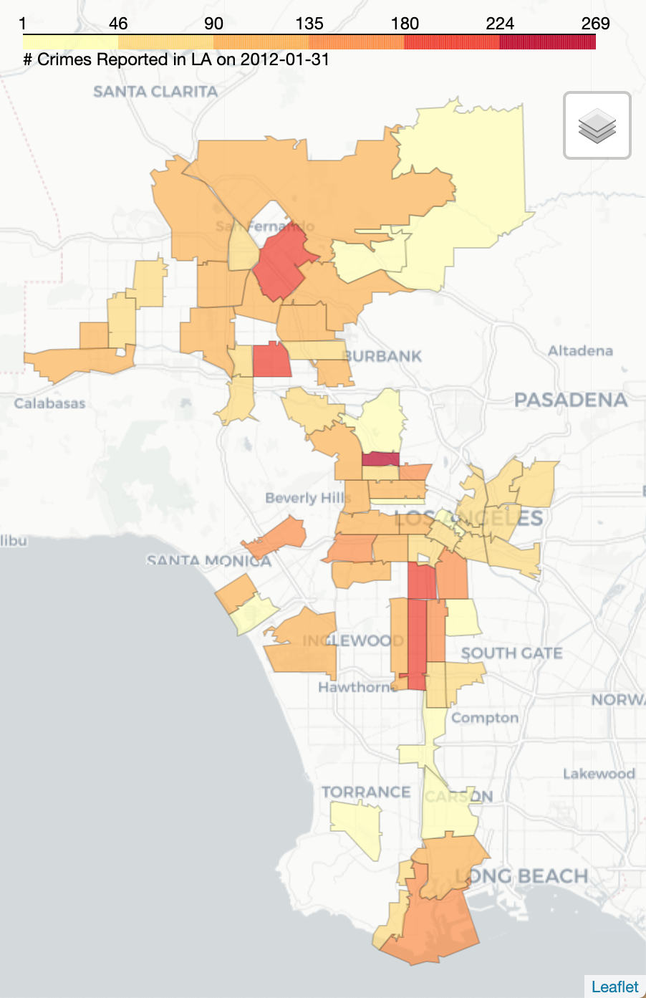
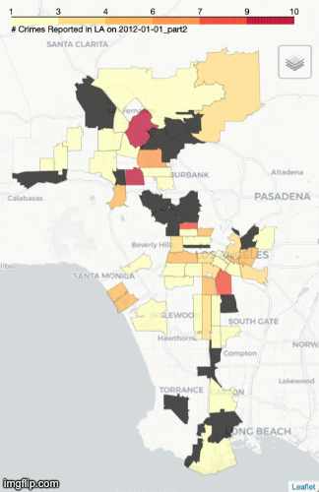
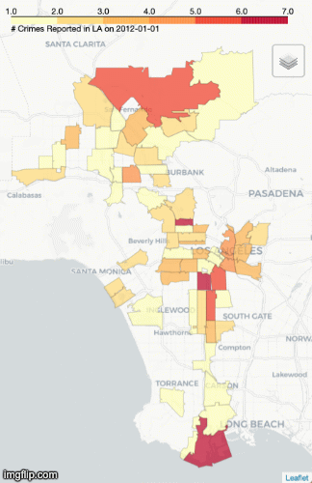
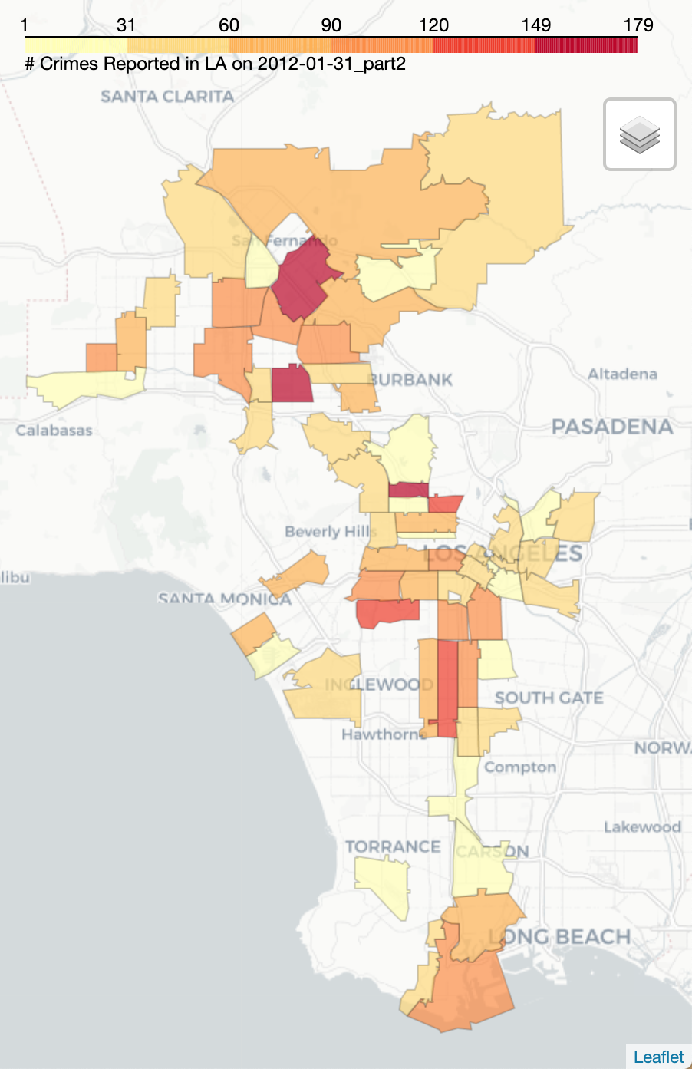
Running the Model on Part 1 vs. Part 2 Crimes:
ONLY PART 1
ONLY PART 2
LOW PART 1, HIGH PART 2:
91401: Median income: $46,420
46% Black, 43% Latinx
91331: Median income: $51,477
88% Latinx
HIGH PART 1, LOW PART 2:
90064: Median income: $84,578
61% white
91367: Median income: $76,548
68% white
Support for the theory that location-based technique still reinforces racial/socioeconomic bias
*https://www.unitedstateszipcodes.org/
*http://www.laalmanac.com/population/po24la_zip.php
Notes:
https://www.zipdatamaps.com/90008

Slide 16
Runaway Feedback Loops
For each day, assume that the algorithm sends L.A.P.D. to the ZIP codes predicted to have the most crime from previous day’s data
Because L.A.P.D. is in particular ZIP codes, they are more likely to discover crime there
Re-run model and increase number of crimes reported in highly-predicted ZIP codes by 20% for each day

Slide 17
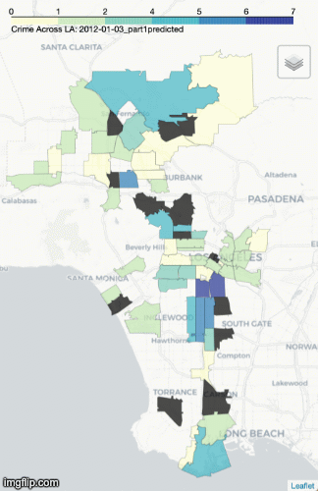
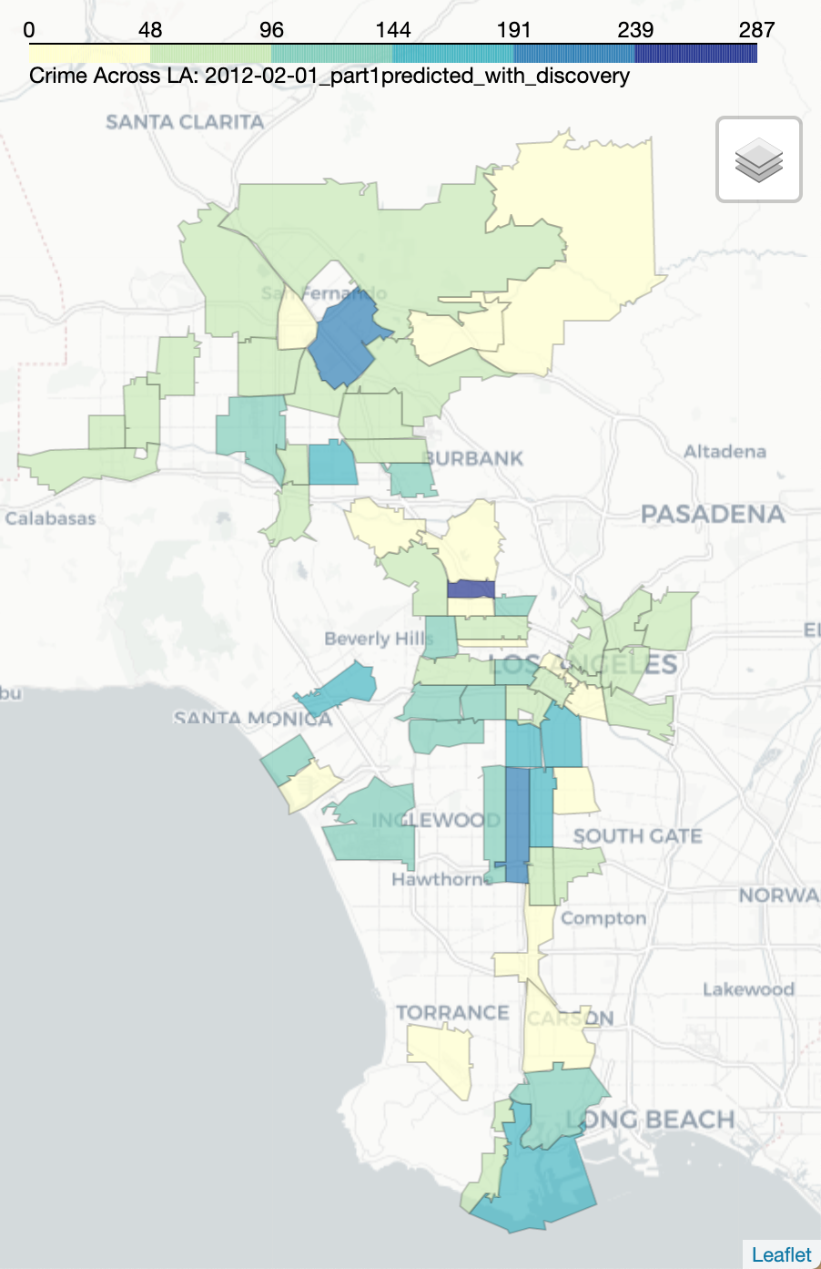
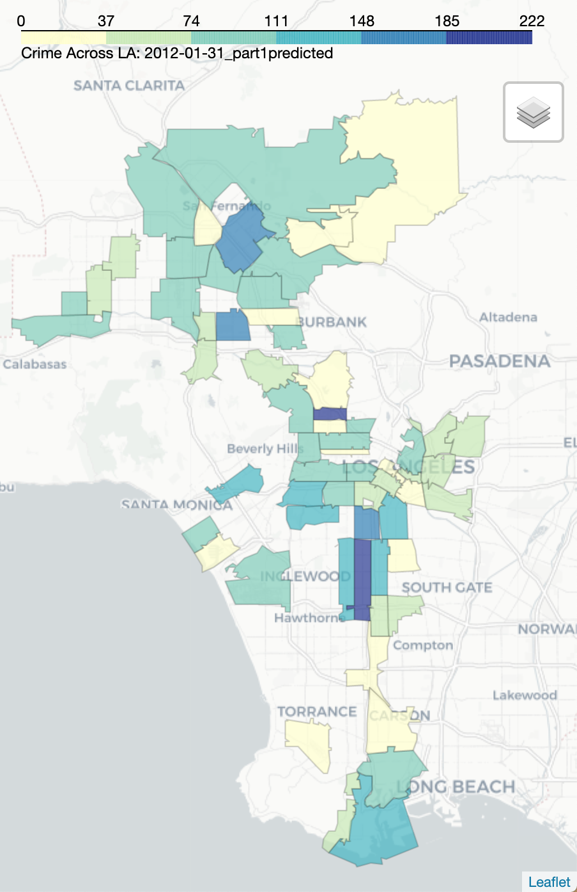
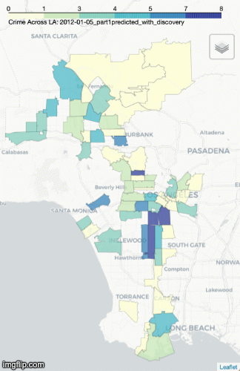
Running the Model after adding “Discovered” Crimes
WITHOUT DISCOVERY
WITH DISCOVERY
Notes:
https://www.zipdatamaps.com/90008

Slide 18
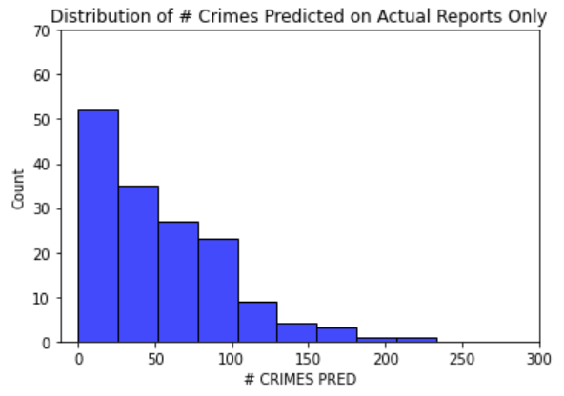
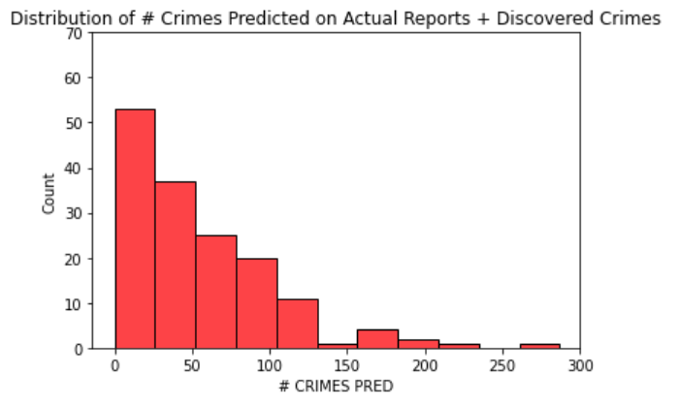
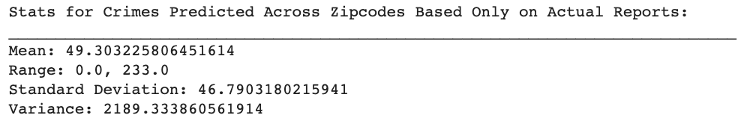
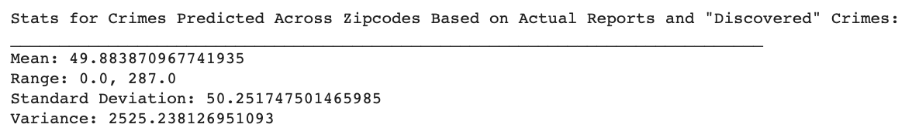
Analyzing Including Discovered Crimes
WITHOUT DISCOVERY
WITH DISCOVERY
Effects of including discovered crimes: higher average crime prediction, greater spread across ZIP codes, top ZIP codes have much higher # crimes predicted

Slide 19
Findings & Limitations:
Predictive policing models could be construed as unethical
Predictive policing models susceptible to training data, interpretation, algorithmic focus, and feedback loop bias which could significantly affect the results and outcome of this tech
Model is same category as most predictive policing algorithms but a simple version
L.A. data has been digitized from handwritten police reports, so potential errors in this process may influence the result
Next steps: different models, different cities, different times

Slide 20
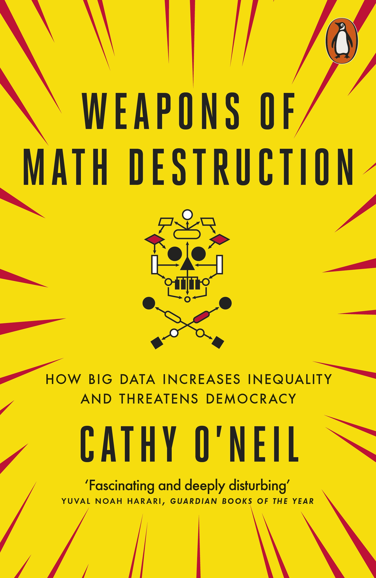
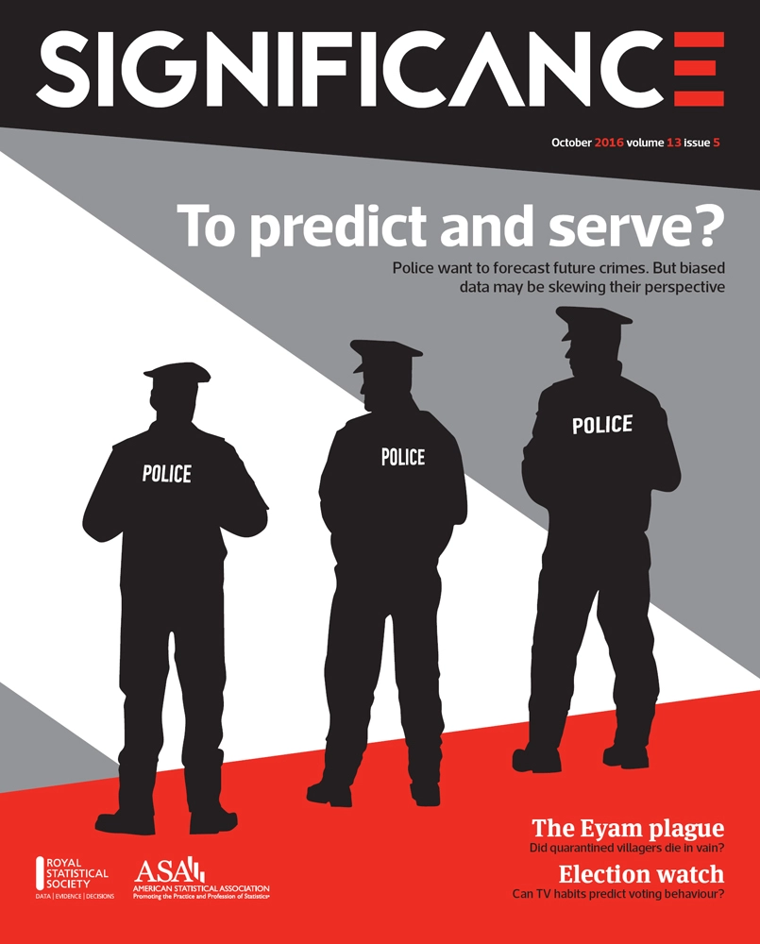
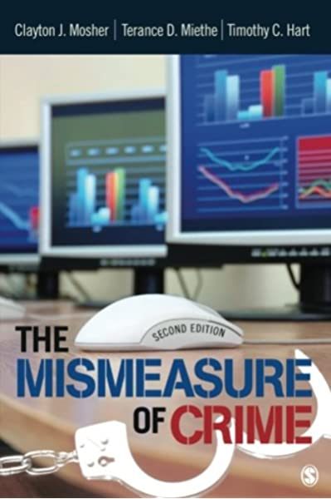

Resources

